Slide 1
Multiplexers and Demultiplexers,
and
Encoders and Decoders

Slide 2
Multiplexers
A multiplexer has
  N control inputs
  2^{N} data inputs
  1 output
A multiplexer routes (or connects) the selected data input to the output.
  The value of the control inputs determines the data input that is selected.

Slide 3
Switching-network logic blocks
Multiplexer (MUX)
  Routes one of many inputs to a single output
  Also called a selector
Demultiplexer (DEMUX)
  Routes a single input to one of many outputs
  Also called a decoder
multiplexer
demultiplexer
We construct these
devices from:
logic gates
networks of tran-
sistor switches
control
control

Slide 4
The “WHY” slide
Multiplexers/Demultiplexers
  If you had the ability to select which input to operate, the same part of a circuit can be used multiple times. So if you have a lot of inputs and all of them are supposed to go through same complex logic functions, you can save a lot of space on your circuit board by using a multiplexer.
  Then you will also need a demultiplexer to decode the output coming out in serial into separate output ports.

Slide 5
“WHY”: Sharing complex logic functions
Share an adder: Select inputs; route sum
A₀ A₁
B₀ B₁
S_{a}
MUX
MUX
S_{b}
multiple inputs
A
B
single adder
Sum
S_{s}
DEMUX
multiple output destinations
Z₀ Z₁

Slide 6
Multiplexers
Basic concept
  2^{n} data inputs; n control inputs ("selects"); 1 output
  Connects one of 2^{n} inputs to the output
  “Selects” decide which input connects to output
  Two alternative truth-tables: Functional and Logical
Functional truth table
Logical truth table
Example: A 2:1 Mux
Z = SIn₁ + S'In_{o}
In₁ In₀ S Z
0 0 0 0
0 0 1 0
0 1 0 1
0 1 1 0
1 0 0 0
1 0 1 1
1 1 0 1
1 1 1 1
S Z
0 In₀
1 In₁
I₀
Z
S
I₁

Slide 7
Multiplexers (con't)
2:1 mux: Z = S'In₀ + SIn₁
4:1 mux: Z = S₀'S₁'In₀ + S₀'S₁In₁ + S₀S₁'In₂ + S₀S₁In₃
8:1 mux: Z = S₀'S₁'S₂'In₀ + S₀'S₁S₂In₁ + ...
I₀
I₁
2:1
mux
I₀
I₁
I₂
I₃
I₀
I₁
I₂
I₃
I₄
I₅
I₆
I₇
Z
4:1
mux
Z
S₀
8:1
mux
Z
S₀ S₁
S₀ S₁ S₂

Slide 8
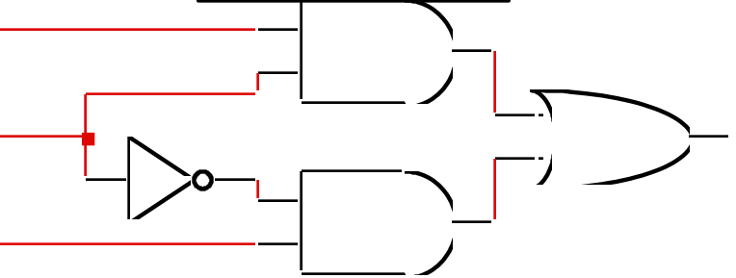
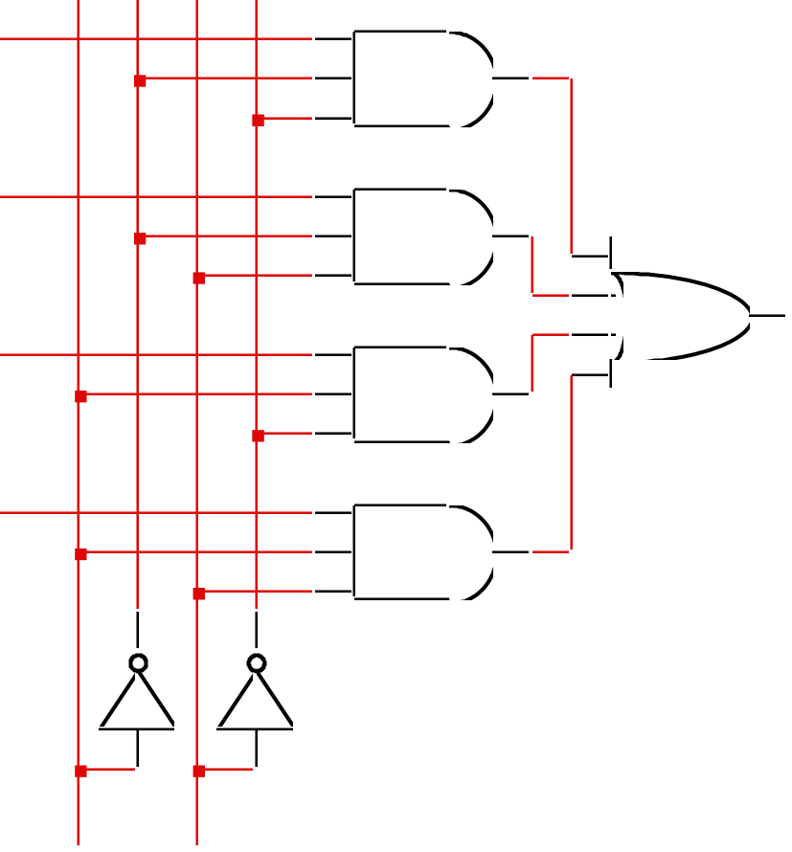
Logic-gate implementation of multiplexers
2:1 mux
4:1 mux
I₀
I₁
I₂
I₃
I₀
Z
S
Z
I₁
Z
S₀ S₁

Slide 9
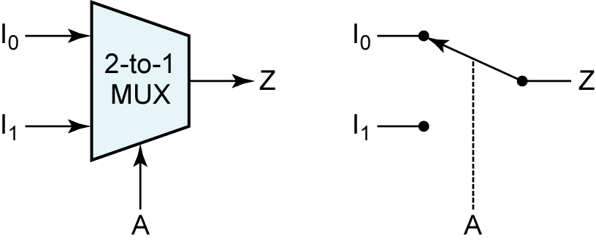
Multiplexers
Data
inputs
Z = A′.I₀ + A.I₁
Control
input

Slide 10
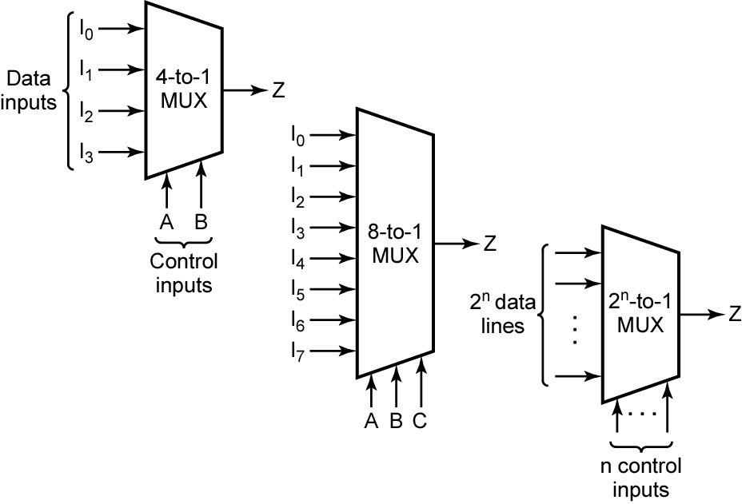
Multiplexers
A | B | F
0 | 0 | I₀
0 | 1 | I₁
1 | 0 | I₂
1 | 1 | I₃
MSB
LSB
Z = A′.B'.I₀ + A'.B.I₁ + A.B'.I₂ + A.B.I₃

Slide 11
Multiplexers
A | B | C | F
0 | 0 | 0 | I₀
0 | 0 | 1 | I₁
0 | 1 | 0 | I₂
0 | 1 | 1 | I₃
1 | 0 | 0 | I₄
1 | 0 | 1 | I₅
1 | 1 | 0 | I₆
1 | 1 | 1 | I₇
MSB
LSB
Z = A′.B'.C'.I₀ + A'.B'.C.I₁ + A'.B.C'.I₂ + A'.B.C.I₃ +
A.B'.C'.I₀ + A.B'.C.I₁ + A'.B.C'.I₂ + A.B.C.I₃

Slide 12
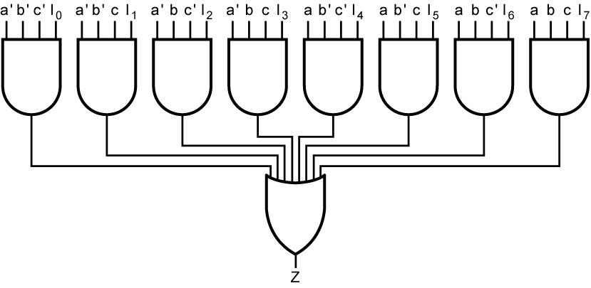
Multiplexers

Slide 13
Multiplexers
Exercise:
Design an 8-to-1 multiplexer using
4-to-1 and 2-to-1 multiplexers only.

Slide 14
Multiplexers
Exercise:
Design a 16-to-1 multiplexer using
4-to-1 multiplexers only.

Slide 15
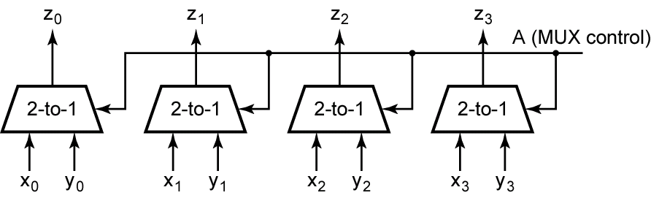
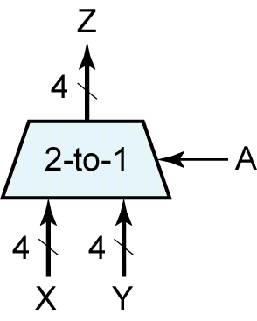
Multiplexer (Bus)

Slide 16
Designing logic circuits using multiplexers

Slide 17
Using an n-input Multiplexer
Use an n-input multiplexer to realize a logic circuit for a function with n minterms.
  m = 2^{n}, where m = # of variables in the function
Each minterm of the function can be mapped to an input of the multiplexer.
For each row in the truth table, for the function, where the output is 1, set the corresponding input of the multiplexer to 1.
  That is, for each minterm in the minterm expansion of the function, set the corresponding input of the multiplexer to 1.
Set the remaining inputs of the multiplexer to 0.

Slide 18
Using an n-input Mux
Example:
Using an 8-to-1 multiplexer, design a logic circuit to realize the following Boolean function
F(A,B,C) = Σm(2, 3, 5, 6, 7)

Slide 19
Using an n-input Mux
Example:
1. Using an 8-to-1 multiplexer, design a logic circuit to realize the following Boolean function
F(A,B,C) = Σm(1, 2, 4)
Use 4:1 mux to solve the above.
2. F(A,B)= Σm(0,2) Use 2:1 multiplexer to implement the function
3. Use basic gates to implement the above function in (2).
Use only NAND gates to implement the above
function.

Slide 20
Using an (n / 2)-input Multiplexer
Use an (n / 2)-input multiplexer to realize a logic circuit for a function with n minterms.
  m = 2^{n}, where m = # of variables in the function
Group the rows of the truth table, for the function, into (n / 2) pairs of rows.
  Each pair of rows represents a product term of (m – 1) variables.
  Each pair of rows can be mapped to a multiplexer input.
Determine the logical function of each pair of rows in terms of the m^{th} variable.
  If the m^{th} variable, for example, is x, then the possible values are x, x', 0, and 1.

Slide 21
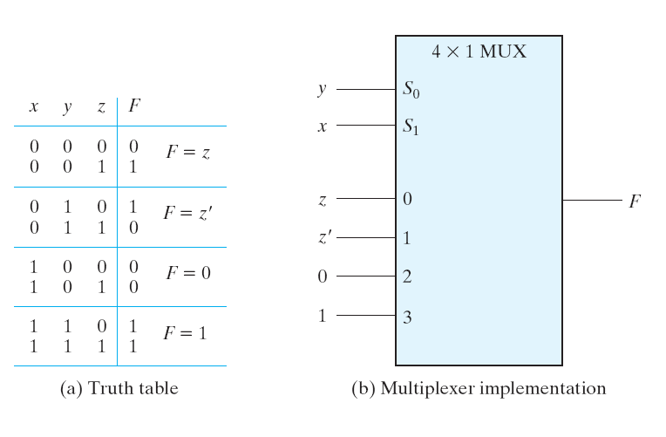
Using an (n / 2)-input Mux
Example: F(x,y,z) = Σm(1, 2, 6, 7)

Slide 22
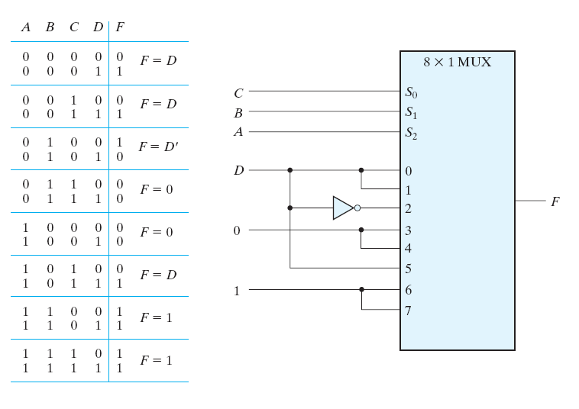
Using an (n / 2)-input Mux
Example: F(A,B,C,D) = Σm(1,3,4,11,12–15)

Slide 23
Using an (n / 4)-input Mux
The design of a logic circuit using an (n / 2)-input multiplexer can be easily extended to the use of an (n / 4)-input multiplexer.

Slide 24
Cascading multiplexers
Can form large multiplexers from smaller ones
  Many implementation options
8:1 mux
8:1 mux
I₀
I₁
I₂
I₃
I₀
I₁
2:1
mux
4:1
mux
2:1
mux
I₂
I₃
2:1
mux
Z
4:1
mux
I₄
I₅
I₆
I₇
Z
4:1
mux
I₄
I₅
2:1
mux
I₆
I₇
2:1
mux
S₀ S₁
S₂
S₀
S₁ S₂

Slide 25
Multiplexers as general-purpose logic
A 2^{n}:1 mux can implement any function of n variables
  A lookup table
  A 2^{n – 1}:1 mux also can implement any function of n variables
Example: F(A,B,C) = m0 + m2 + m6 + m7 = A'B'C' + A'BC' + ABC' + ABC
= A'B'(C') + A'B(C') + AB(0) + AB(1)
A B C F
0 0 0 1
0 0 1 0
0 1 0 1
0 1 1 0
1 0 0 0
1 0 1 0
1 1 0 1
1 1 1 1
1
0
1
0
0
0
1
1
0
1
2
3
4
5
6
7
C'
C'
0
1
F
C'
C'
0
1
0
1
2
3
F
8:1 MUX
4:1 MUX
S1
S0
S2
S1
S0
A B
A B C

Slide 26
Multiplexers as general-purpose logic
Implementing a 2^{n-1}:1 mux as a function of n variables
  (n-1) mux control variables S₀ – S_{n–1}
  One data variable S_{n}
  Four possible values for each data input: 0, 1, S_{n}, S_{n}'
  Example: F(A,B,C,D) implemented using an 8:1 mux
AB
A
00
01
11
10
1
D
0
1
D'
D
D'
D'
CD
0
1
2
3
4
5
6
7
Choose A,B,C as
control variables
Choose D as a
data variable
00
1 0 1 1
1 0 0 0
1 1 0 1
0 1 1 0
8:1
MUX
F
01
D
11
C
10
S2
S1
S0
B
A
B
C

Slide 27
Demultiplexers

Slide 28
Demultiplexers
A demultiplexer has
  N control inputs
  1 data input
  2^{N} outputs
A demultiplexer routes (or connects) the data input to the selected output.
  The value of the control inputs determines the output that is selected.
A demultiplexer performs the opposite function of a multiplexer.

Slide 29
Demultiplexers
Out₀
W
W = A'.B'.I
Out₁
X
X = A.B'.I
I
In
Y
Out₂
Z
Y = A'.B.I
Out₃
S₁
S₀
Z = A.B.I
A
B
A | B | W | X | Y | Z
0 | 0 | I | 0 | 0 | 0
0 | 1 | 0 | I | 0 | 0
1 | 0 | 0 | 0 | I | 0
1 | 1 | 0 | 0 | 0 | I

Slide 30
Decoders

Slide 31
Decoders
A decoder has
  N inputs
  2^{N} outputs
A decoder selects one of 2^{N} outputs by decoding the binary value on the N inputs.
The decoder generates all of the minterms of the N input variables.
  Exactly one output will be active for each combination of the inputs.
What does “active” mean?

Slide 32
Demultiplexers (DEMUX)
Basic concept
  Single data input; n control inputs (“selects”); 2^{n} outputs
  Single input connects to one of 2^{n} outputs
  “Selects” decide which output is connected to the input
  When used as a decoder, the input is called an “enable” (G)
1:2 Decoder:
Out0 = G • S'
Out1 = G • S
2:4 Decoder:
Out0 = G • S1' • S0'
Out1 = G • S1' • S0
Out2 = G • S1 • S0'
Out3 = G • S1 • S0
3:8 Decoder:
Out0 = G • S2' • S1' • S0'
Out1 = G • S2' • S1' • S0
Out2 = G • S2' • S1 • S0'
Out3 = G • S2' • S1 • S0
Out4 = G • S2 • S1' • S0'
Out5 = G • S2 • S1' • S0
Out6 = G • S2 • S1 • S0'
Out7 = G • S2 • S1 • S0

Slide 33
Logic-gate implementation of demultiplexers
2:4 demux
G
Out₀
Out₀
Out₁
G
S
Out₂
Out₁
Out₃
S₁
S₀

Slide 34
Decoders
W = A'.B'
Out₀
W
B
I₀
Out₁
X
X = A.B'
A
I₁
Out₂
Y
Y = A'.B
Out₃
Z
msb
Z = A.B
Active-high outputs
A | B | W | X | Y | Z
0 | 0 | 1 | 0 | 0 | 0
0 | 1 | 0 | 1 | 0 | 0
1 | 0 | 0 | 0 | 1 | 0
1 | 1 | 0 | 0 | 0 | 1

Slide 35
Decoders
W = (A'.B')'
Out₀
W
B
I₀
Out₁
X
X = (A.B')'
A
I₁
Out₂
Y
Y = (A'.B)'
Out₃
Z
msb
Z = (A.B)'
Active-low outputs
A | B | W | X | Y | Z
0 | 0 | 0 | 1 | 1 | 1
0 | 1 | 1 | 0 | 1 | 1
1 | 0 | 1 | 1 | 0 | 1
1 | 1 | 1 | 1 | 1 | 0

Slide 36
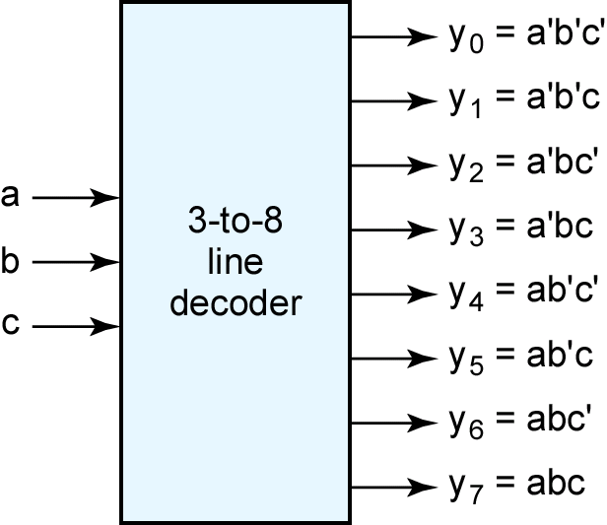
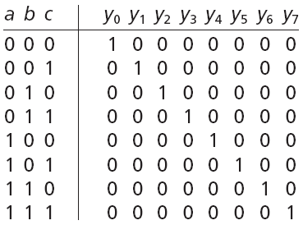
Decoders
msb

Slide 37
Decoder with Enable
Out₀
W
B
I₀
high-level
enable
Out₁
X
A
I₁
Y
Out₂
Out₃
Z
Enable
En
En | A | B | W | X | Y | Z
1 | 0 | 0 | 1 | 0 | 0 | 0
1 | 0 | 1 | 0 | 1 | 0 | 0
1 | 1 | 0 | 0 | 0 | 1 | 0
1 | 1 | 1 | 0 | 0 | 0 | 1
0 | x | x | 0 | 0 | 0 | 0
enabled
disabled

Slide 38
Decoder with Enable
Out₀
W
B
I₀
low-level
enable
Out₁
X
A
I₁
Y
Out₂
Out₃
Z
Enable
En
En | A | B | W | X | Y | Z
0 | 0 | 0 | 1 | 0 | 0 | 0
0 | 0 | 1 | 0 | 1 | 0 | 0
0 | 1 | 0 | 0 | 0 | 1 | 0
0 | 1 | 1 | 0 | 0 | 0 | 1
1 | x | x | 0 | 0 | 0 | 0
enabled
disabled

Slide 39
Decoders
Exercise:
Design a 4-to-16 decoder using
2-to-4 decoders only.

Slide 40
Encoders

Slide 41
Encoders
An encoder has
  2^{N} inputs
  N outputs
An encoder outputs the binary value of the selected (or active) input.
An encoder performs the inverse operation of a decoder.
Issues
  What if more than one input is active?
  What if no inputs are active?

Slide 42
Encoders
D
I₀
C
I₁
Out₀
Z
Out₁
Y
B
I₂
A
I₃
A | B | C | D | Y | Z
0 | 0 | 0 | 1 | 0 | 0
0 | 0 | 1 | 0 | 0 | 1
0 | 1 | 0 | 0 | 1 | 0
1 | 0 | 0 | 0 | 1 | 1

Slide 43
Priority Encoders
If more than one input is active, the higher-order input has priority over the lower-order input.
  The higher value is encoded on the output
A valid indicator, d, is included to indicate whether or not the output is valid.
  Output is invalid when no inputs are active
    d = 0
  Output is valid when at least one input is active
    d = 1
Why is the valid indicator needed?

Slide 44
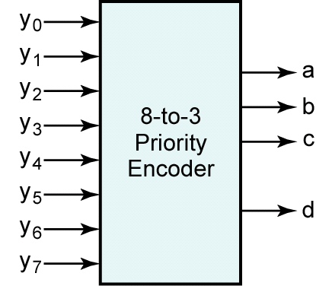
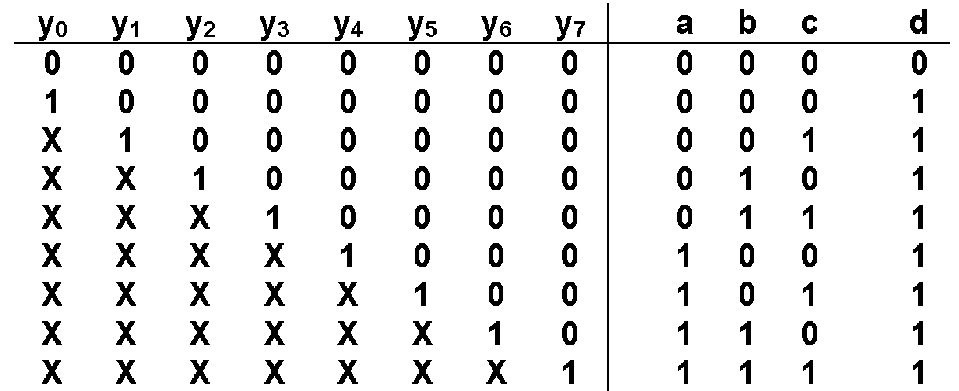
Priority Encoders
msb
Valid bit

Slide 45
Designing logic circuits using decoders

Slide 46
Using an n-output Decoder
Use an n-output decoder to realize a logic circuit for a function with n minterms.
Each minterm of the function can be mapped to an output of the decoder.
For each row in the truth table, for the function, where the output is 1, sum (or “OR”) the corresponding outputs of the decoder.
  That is, for each minterm in the minterm expansion of the function, OR the corresponding outputs of the decoder.
Leave remaining outputs of the decoder unconnected.

Slide 47
Using an n-output Decoder
Example:
Using a 3-to-8 decoder, design a logic circuit to realize the following Boolean function
F(A,B,C) = Σm(2, 3, 5, 6, 7)

Slide 48
Using an n-output Decoder
Example:
Using two 2-to-4 decoders, design a logic circuit to realize the following Boolean function
F(A,B,C) = Σm(0, 1, 4, 6, 7)

